Slide 1

8600-315 : Understanding Recruitment and Selection of New Staff in the Business Workplace
Business Administration

Slide 2
Introduction
Recruitment (招聘) and selection is the process of identifying the need for a job, defining (定义) the requirements of the position, advertising the position and choosing the most appropriate person for the job.
In this module we look at the first stage of managing people – attracting and selecting staff. Recruitment and selection are usually considered as one process. However, we will make the distinction here between the initial actions (初步行动) and considerations (考虑) when planning staff recruitment and the process of selecting an individual from a pool (collection) of applicants.

Slide 3

Recruitment needs to be carefully planned in order to attract the right type of applicant (吸引合适的类型的申请人). This increases the chances of making a suitable selection and appointment. Your involvement may be limited to a discussion of the need for a particular job within your team or work area, or you may be required to interview job applicants.
Whatever your involvement, this module makes it clear that it is important for you to understand the whole process to make an effective contribution (有效的贡献) to the staffing of your organisation.

Slide 4
Recruitment Policies and Procedures (招聘政策和程序)
Finding and hiring competent/capable (胜任) and quality staff is a challenge facing large, medium and small businesses. Many companies find that it is even harder today to compete for talent (天赋) and that as a result, many hire new staff quickly just to have somebody fill a position left vacant.

Slide 5
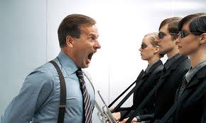
This often leads to the expensive consequences (后果) of a bad hire - workplace disruption (工作场所中断), lost productivity (生产力的损失), increased stress, and deceased morale (死者士气). In addition, firing a "bad hire" creates workplace anxiety (职场焦虑) and legal and personal complications (法律和个人的并发症) and expenses.

Slide 6
To make the best hiring choice, companies must make a commitment (承诺) to the importance of the hiring process, instead of rushing through it.
Creating Recruitment Policies is the first step. Companies who develop common-sense (常识) recruitment policies are the most effective at identifying, attracting and retaining (keeping) quality employees. However, few companies and recruiters have policies in place that address issues surrounding effective recruitment.

Slide 7

Constantly hiring new staff hinders (阻碍) production.
A solid recruitment strategy reduces turnover and training and their other costs which in turn create a loyal (忠诚) and skilled staff, increasing productivity and profits.

Slide 8
While it is difficult to determine the exact cost of hiring a new employee, research in this area estimates (guess 估计) that it costs the average company between $8,000 and $12,000 to hire and train each new employee.
This expense cannot be ignored as these costs directly impact the company's productivity and the budget. Hiring the right person the first time will help reduce the number of new staff your company has to hire and train, thereby reducing overall operating costs (降低整体营运成本).

Slide 9
Hiring a bad employee can be bad, especially in small-medium sized companies. They can tie the company up for months because management is afraid to do anything for fear of a lawsuit (sue 起诉), but at the same time, the company's needs are not being met.
Avoid this situation (避免这种情况发生) by developing and implementing effective Recruitment Policies. Having a consistent (一贯) hiring process will ensure you minimise bad hiring decisions.

Slide 10
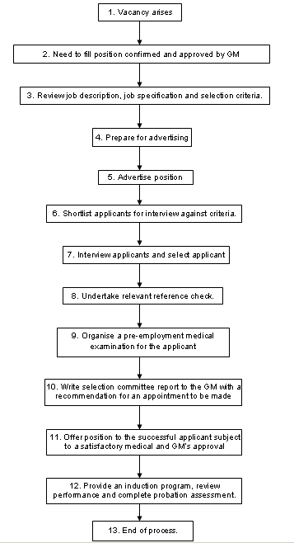

Slide 13
Legal (法律) Aspects (方面) of Recruitment
While a sound (strong/solid/good) recruitment process helps in appointing the most capable person, it is also essential (important) to ensure that you fulfill all legal requirements (履行所有法律要求). The law that governs recruitment is not designed to constrict (压迫 control) an organisation’s choice, it is rather to ensure fair access to jobs.

Slide 14
The employer has the legal responsibility to ensure that no unlawful discrimination (非法歧视) occurs in the recruitment and selection process on the grounds of sex, race, disability, age, and religion (宗教) or belief.
Equality of opportunity is an integral (important 积分) part of the recruitment and selection process, and employers may offer training and encouragement to any under-represented groups.
Examples include pre-application assistance for those who do not have English as their first language, or management development training for women where they are under-represented in management grades.

Slide 15

Job advertisements may also state that the employer encourages (鼓励) applications from those groups that are under- represented in the organisation.
Employees and their representatives will also have an interest in fair, non-discriminatory recruitment and selection policies, and they should be fully consulted (咨询) when new procedures are introduced or existing procedures reviewed.

Slide 16
The most common problem that can occur during recruitment is that an applicant experiences discrimination (区别). This may be deliberate (故意的) or unintended (意外).
There are two main forms of discrimination:
Direct discrimination arises when a person treats another person or group of people less favourably (逊色 inferior) in a particular situation because of their race, religion, ethnic origin (民族起源), gender (sex), marital status, disability, sexual orientation (gay/lesbian) or gender reassignment (transsexual).

Slide 17
Indirect discrimination means specifying (指定) a requirement or condition which, although applied equally to persons of all groups, for example:
A translation company insists that all those applying for jobs as translators have driving licenses because there is an occasional need to deliver or collect work from clients. Since this prevents (stops) some people with disabilities (残疾) from applying and as driving is not a core (main) requirement for doing the job, the company is effectively discriminating (鉴别) against this particular group of people, unless they can demonstrate (演示) that there is an reason to justify the policy (一个理由来证明政策).

Slide 18
Another example: A department store prohibits (disallow 禁止) its employees from wearing hats when serving customers. This rule means that people whose religious beliefs require them to cover their heads, such as Muslim women, are prevented from working in the shop. The store is indirectly discriminating against this group of people unless it can demonstrate (演示) that there is an reason to justify the policy (一个理由来证明政策).

Slide 19
The law sets the parameters (参数) for good practice and protects people and organisations from unfairness and inequality. Adopting good equal opportunities practice within your recruitment and selection process matters.
An organisation with a wide employee base presents an attractive image to a greater range of potential (潜力) recruits (applicants 申请人).

Slide 20
Morale and motivation (士气和积极性) increase as employees see you recruiting people on factors that matter. This in turn reduces employee turnover and the need for yet more costly recruitment.
Your customer service standards improve and your customer base can grow. A greater empathy (relationship 神入) develops between staff and customers, so your reputation is enhanced (improved).
There is less chance of being prosecuted (起诉) under equal opportunities laws, which means that fines and costs, as well as bad publicity (坏的宣传) are avoided.

Slide 21
The following will help you make certain that your recruitment policy conforms to good equal opportunities practice:
Make sure your organisation’s equal opportunities policy complies (follows) with current legislation (法例) and best practice.
Be involved personally at every step of the recruitment and selection process.
Make sure everyone clearly understands what’s involved and is trained in key skills.

Slide 22
Look into ways of widening access to jobs, for example by working with local community groups and carrying out projects with local schools.
Assess ways of making your organisation more attractive, for example by offering flexible working (灵活的工作) and reviewing local childcare options.
Consider changing the way you recruit for posts. Traditional ways would be CV/Resume and interviews.

Slide 23
Discuss with others the idea of introducing ‘positive action’. This is the practice of encouraging members (鼓励会员) of certain ethnic (民族), gender or other specific groups to apply for positions previously held or mainly by members of different groups over the previous 12 months. Lead by example and only discriminate basing on merit (deeds 优点), capability and performance.

Slide 24
! Assignment
Identify an organisation’s policies and procedures that could guide the manager in recruitment and selection. 确定组织的政策和程序，可以指导经理在招聘和选拔。(12 marks)
Guide: An appropriate range of an organisation’s policies and an appropriate range of procedures that could guide the manager in recruitment and selection are clearly identified.

Slide 25

Job Analysis (工作分析)
Job analysis means adopting a method for establishing what is required to perform a job efficiently and effectively. 工作分析是指采用的方法确定需要什么来有效地执行工作。
Job analysis helps you to assess (评估) your requirements for the future.

Slide 26
Who To Involve?
Who you involve in a job analysis is largely dependent on how simple or complex (复杂) the exercise is. At the very minimum it will be the employer and the jobholder.
However, there is a strong case for involving others. For example, it can be useful to gain the view of the manager who can see the job within the organisation better than most people.

Slide 27
It can also be helpful to include people who may be affected by the job, such as other parts of the business, customers or suppliers. It’s useful to gain their views on what changes would help to improve the quality of service they receive.
If the job is technical or complex (技术或复杂的), you could also include others with expertise (专门知识) in the same or similar activities.
If you have a human resource department (人力资源部门), it should clearly be involved.

Slide 28

What you need to find out
Job analysis will need to identify:
The purpose of the role.
The tasks and responsibilities that are required of the jobholder.
The skills, knowledge and abilities needed for effective performance.
The targets that are used to measure performance.

Slide 29
Job Analysis Methodology
Observation - This is probably the most straightforward (简单的) and easy-to-use technique. It involves recording everything the jobholder is doing as part of the job.
It provides an overview of a job (它提供了一个概述的工作), but does not highlight the level of difficulty of the various tasks or the importance of each. It can be made more meaningful if the jobholder is also interviewed while performing the role.
It works best for routine activities (日常活动) where the tasks can be seen in sequence (序列), such as machine operation or on a production line.

Slide 30

Diaries and Logs (日记和日志) - This involves the jobholder recording what they do. This might happen at the end of a given time period or when they change from one activity to another.
This method can be useful for jobs where the day-to-day activities are not easily observable (观察到的), for example, in management.
However, it can become subjective (主观) as the jobholder concentrates (focuses) only on those areas of work that they consider to be important.

Slide 31

Job Analysis Interviews - This involves interviewing the jobholder, without a predetermined list of questions or checklist, thus bringing greater flexibility to the discussion.
It can involve talking about the job description or bringing two jobholders together to talk about their work.
It can be used for a variety (different) of jobs and requires strong interviewing techniques on the part of the manager.

Slide 32
Critical Incident Technique - This concentrates on collecting information about critical incidents (关键事件) that are related to success and failure in a job.
The incidents are recorded in relation to how the person handles certain situations.
The analysis can take place through keeping a log, completing a report and/or interviews.
It is useful for a range of jobs but can be time-consuming (耗时) as many incidents must be recorded to obtain a full picture.

Slide 33

Repertory Grid (凯利方格) - Like critical incident analysis, this allows the identification of good and poor performance. It is generally undertaken with the manager or supervisor of people doing the same job, using a system of cards.
The names of three people are written on cards, separated into two piles - one for good performers, one for poor. The supervisor then pulls out two good and one bad, and is asked to describe how the two good performers are similar and how they differ from the bad.

Slide 34
Checklist/Inventories - This involves developing a list of tasks associated (related) with a job and asking the jobholder to indicate which ones they perform and to rank them in order.
While one checklist is needed for each job, it is a method that can be used for all types of jobs. It also produces some quantifiable data (可量化的数据) because of the ratings people provide.
Quantifiable data - data that can be counted or tallied.

Slide 35

The Job Description and Person Specification
The job description (职位描述) states the purpose, responsibilities and conditions of the job.
The person specification (人规范) outlines the abilities and qualities that would best fit the job.

Slide 36
Why these documents are important?
The job description is at the heart of any recruitment you undertake. The information is obtained from doing a job analysis and it specifies (指定) exactly what the job involves.
It is important in developing the person specification as it can also be used as the basis (基础) of advertising and be sent to applicants requiring further information.

Slide 37

The job description provides accurate information (准确的信息) of what the job involves on a daily basis.
This last point is important and can save you time and money. If potential applicants (潜在申请人) can identify whether they are capable of doing the job, then inappropriate people usually rule themselves out an early stage.

Slide 38

The person specification is used as the basis of the selection process.
It can be used in marketing the role, makes shortlisting and selection easier, and helps to make the process objective.
This is because all parties are clear about the qualities and abilities being sought.

Slide 39
Writing a Job Description
A good job description will include:
Job title.
Location / department / areas of the business.
The overall purpose of the job.
The title of the person to whom the jobholder reports.
The title of any employees who report to the jobholder.

Slide 40

The main duties and responsibilities of the post, prioritised (优先) in some way.
Any other significant information, such as special working conditions.
The date of issue.

Slide 41
Checklist - Writing a Job Description
Check that it does not overstate (夸大) the importance and scope of the role.
Make sure that there is no bias (prejudice 偏见) in terms of gender, age, marital status or disability.
Ensure sexist language has been avoided.
Make sure the language is clear and easily understood by someone from outside the organisation.

Slide 42
Check it doesn’t include jargon (行话), acronyms (首字母缩略词) or abbreviations (缩写) and use as few technical terms as possible.
Consider offering flexible working arrangements (灵活的工作安排) such as the possibility of a job-share.
Avoid including an age range as it is meaningless in determining past experience and you may eliminate (消除) the most capable candidate.
Make sure the audience it is aimed at can easily understand it.
Notes:
Job-share - Alternative work schedule in which two employees voluntarily share the responsibilities of one full time job, and receive salary and benefits on pro-rata basis.

Slide 43
Putting together a Person Specification
The person specification is obtained from the job description. The factors you include in the person specification will be the criteria (requirement 标准) which you will judge (判断) to see if candidate is suitable (合适的) for the job.
Criteria must be realistic (标准必须是现实的).

Slide 44
Formats for developing a person specification
The two most widely known formats for developing a person specification are Rodger’s seven-point plan (1952) and Munro Fraser’s five-fold grading (1954).
Rodger’s Seven Point Plan | Fraser’s Five Fold Grading
Physical make-up | Impact on others
Attainments | Qualifications or Acquired knowledge
General Intelligence | Innate Abilities
Special Aptitudes | Motivation
Interests | Adjustments or Emotional balance
Disposition
Circumstances

Slide 45
The most common format usually includes the following information
Skills required such as planning, communication and team working.
Knowledge requirements such as ability to work with computers, handle statistics (统计), writing reports.
Experience such as previous types of job and relevant interests.

Slide 46

Educational qualifications, professional qualifications, technical skills.
Special requirements such as shift work, a valid driving license, physical demands of the job.

Slide 47
Checklist - Putting Together a Person Specification
Directly related to the job description.
Ability-based in line with the requirements of the role.
Realistic (实际).
Clearly defined.

Slide 48

Example
CHEF
Summary:
This is administrative and supervisory work (管理和监督工作) in a major food establishment.
Work involves regular food preparation in accordance with (following) recipes (食谱) and menus (菜单). Work requires training employees in food service and preparation and inventory (stock) control. Activities and decisions are varied in nature, requiring independent action and judgment (判断) in solving common problems.

Slide 49

Unusual cases or questionable matters are resolved with this position's supervisor or other appropriate positions.
Duties & Responsibilities:
Supervises production of all menus
Participates in personnel actions
Supervises ordering, purchasing, receiving, and inventory
Supervises sanitation and cleaning
Trains employees
Develops and presents special events
Participates in menu development, recipe testing, and evaluation (评价)
Maintains records and computer input
Maintains food costs, safe handling and preparation standards

Slide 50

Requirements:
Good communication skills (written and verbal)
Able to work as a team
Able to work with all types of people (staff and non-staff)
Excellent time management skills
Able to use MS Office
Strong organisational skills
Able to resolve problems independently
Fluent in Engish
Have at least a degree in culinary arts
Have at least 5 years experience as a chef
Specialised in (ie. Western/Chinese/Japanese/etc.) cuisine

Slide 51
! Assignment
Explain how to conduct a job analysis and prepare a job description and person specification for an identified post. (36 marks)
Guide: A detailed explanation of how to conduct a job analysis and prepare a job description and person specification for an identified post is given which may include examples of the documents involved.

Slide 52
Methods of Advertising
Good equal opportunities (平等机会) practice in recruitment advertising:
Avoid (避免) specifying age or requesting qualifications (资格) that only the young may have.
Avoid using terms such as ‘young’, ‘energetic’ (有活力), which again imply the suitability of young people (意味着适合年轻人).
Avoid being gender specific in job titles and refer to potential candidates as ‘he/she’ or ‘they’.

Slide 53

Avoid photographs that show a particular type of applicant, for example showing a picture of all-male, all-white, twenty-something employees suggests that you are looking for this type of person.
Avoid symbols (符号) or visuals that represent strength and power - usually associated with a male, for example certain types of animals such as tigers and lions.

Slide 54

Avoid overstating (夸大) the job - you may get somebody who is highly qualified (高素质的) but who is not the most suitable person for the job.
The job description and person specification should always be the basis (应始终是基础) of a recruitment advertisement.

Slide 55
Four main choices in Press Advertising
The National Press - this is usually in the ‘quality’ press such The Times, The Telegraph and The Guardian in the UK. These papers tend to feature different types of jobs on different days.
Local Press - often the best choice for non-specialist jobs, as they will reach a wide audience if you are looking for local labour. Some city-based papers have a huge circulation, some local papers are part of a group of publications and may offer reduced rates in their sister papers.

Slide 56
Location | Advantages | Disadvantages
National Press | Good for senior posts or those where skills are scarce Will reach national audience | Costly – based on size of advert and location on the page
Local Press | Good for all and senior and highly specialised posts Relatively inexpensive | May not look as professional as advertising in the nationals Can miss some able applicants who may live out of area
Trade Press | Good for specialised and technical posts Usually a mid – priced option | Be wary of claims for large readership figures which may not be the same as publications sold

Slide 57
Location | Advantages | Disadvantages
Minority Press | Will clearly target certain sectors of the population Can be an expensive option | May miss a wider audience Could be additional costs involved if the advert needs translating

Slide 58
Getting the best from the press
Before advertising in the press, make sure you know the following:
The paper’s circulation figures (how many papers they distribute 分配 in a day) and / or readership profile (who reads the paper).
The paper’s geographical coverage (地域覆盖范围).
The best day to advertise for the post you have available.
On which page of the publication your advert will appear.

Slide 59



What is the cost of the advertisement placements.
What is the cost of the advertisement size.

Slide 60
Working with an agency
Deciding whether to work with an advertising agency (广告公司) will depend on a range of factors such as the type of job you are advertising and your budget (预算).
Using an agency can seem expensive option but may be cost-effective in the long term. For example, the agency may be able to negotiate discounts (协商折扣) for space.
Able to design the ‘right’ advertisement for you.

Slide 61
Putting together a recruitment advert
There are three areas to consider when designing an advertisement for the press. They are size, style and content.
Size
The size will be affected by the following factors:
Your budget.
The amount of information about the job required to be posted.

Slide 62
The importance of the post to the organisation.
The size of other adverts competing for similar candidates.
Style
The style is to do with the way the advert looks on the page. It consists of four elements:
Layout - Use the border of the advert to draw the reader into it. Avoid using smaller fonts to fit in more words - it will only looked cramped (狭窄). Easy-to-read with plenty of white space is more appealing (嬛), even if it means reducing details.

Slide 63
Typeface - Choose a common typeface (font) and use upper and lower case as it’s easier to read. If you have corporate guidelines on typeface and design, then use them as it helps promote the right image.
Visuals - These are nice to have but can be expensive. So if your budget is limited, a larger advertisement is probably better than one that’s elaborate (缜密) but smaller.
Colour - As with visuals, colour can be expense. However, you may want to consider a small area of single colour that can attract the reader’s eye if everything on the page is black and white.

Slide 64
Content
The following details are all relevant:
Name of the organisation.
Location, size and brief details about the organisation.
Job title and basic information based on the job description.
Job tenure, for example length of contract.

Slide 65
Skills and qualities needed, based on the person specification.
Any essential qualifications.
Salary and other benefits.
Hours and any flexible working on offer.
How, where and to whom to apply.
The closing date.
Telephone number plus fax or e-mail address to request an application form and further details.

Slide 66
A checklist of points to bear in mind when preparing a recruitment advert
Do… | Don’t…
Use the organisation’s name, the job, the location and salary in the heading | Exaggerate (夸大) the job or the organisation’s track-record (组织的跟踪记录)
Include any organisational successes, e.g. recent growth | Include criteria that applicants do not need to meet to make the job sound more attractive
Be specific about salary
Highlight benefits that may attract applicants, especially if the salary is not overly attractive | Use words that make the job more interesting - they are meaningless and can deter (discourage 阻止) some applicants
State what development opportunities are on offer

Slide 67
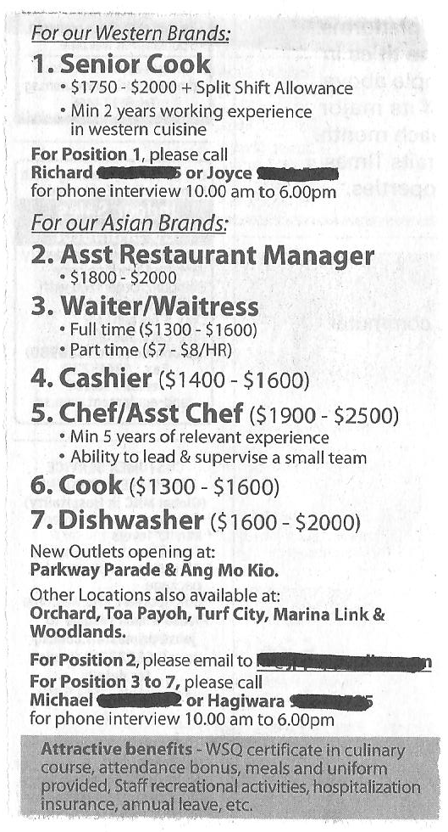
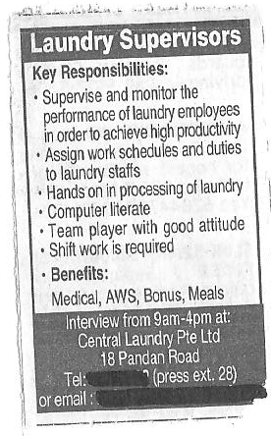

Slide 68
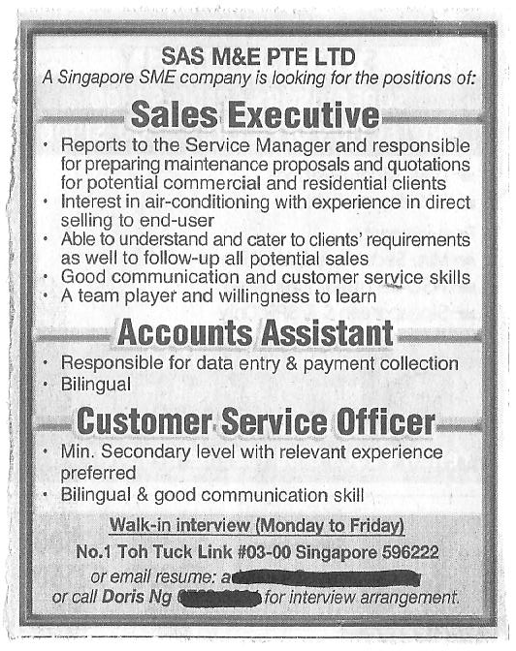

Slide 69
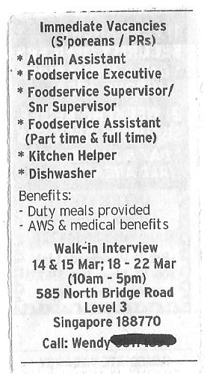
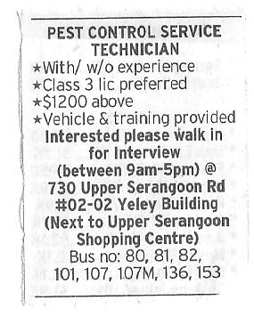

Slide 70
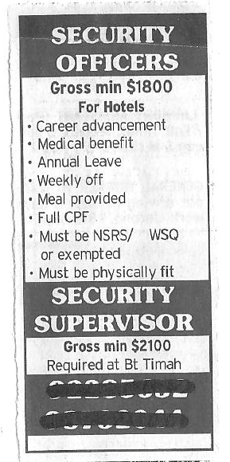
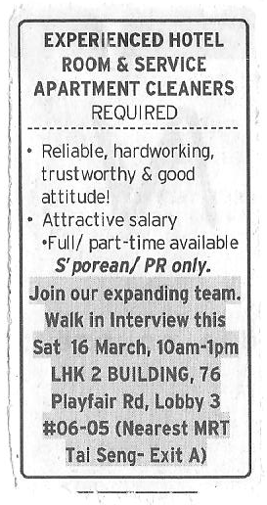

Slide 71
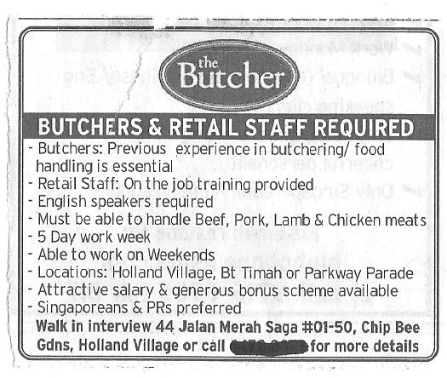

Slide 72
Using the Internet
The Internet is an increasingly popular way of recruiting staff because it is quick and relatively easy. Online job sites use technology to offer three main benefits to employers:
The option to post a job on the job board.
Screening and assessment of applicants against pre-set criteria (预先设定的标准，对申请人的筛选和评估).
Access to a database of CVs (简历 curriculum vitae) from potential applicants already registered with the agency.

Slide 73

Alternative methods of recruitment
While the traditional route of attracting applicants for a vacant post is through press advertising, there are alternative approaches. Some of these can be arranged in-house (internal), while others involve using on external specialists.

Slide 74
In-house Recruitment
Many employers undertake at least some if not most of their own in-house recruitment, using their human resources department (人力资源部), hiring managers and recruitment personnel (招聘人员).
In-house recruiters may advertise job vacancies on their own websites, coordinate internal employee referrals (转介), focus on campus graduate recruitment.

Slide 75
External organisations
Employment Agencies
Employment agencies generally have a large database of job seekers. They tend to specialise in jobs that are relatively low level and common across organisations, such as admin. staff, drivers or warehouse operatives. For a fee they will match your needs with people registered with them and will fill vacancies quickly.

Slide 76
Recruitment Consultancies
These organisations tend to specialise in management or sales posts. They generally have individuals on their lists who may be either employed or unemployed.
You will need to manage any consultancy relationship and brief consultants very carefully. It’s also important to ensure they match the person to your job, rather than the other way round, otherwise you could end up with an unsuitable employee.

Slide 77

Outplacement Consultancies
These are organisations dealing specifically with people who have been made retrenched (被裁), often from managerial and professional roles. Costs are relatively low and the calibre (口径 quality) of people can be high. In addition, the consultant is likely to know the individual well as they work closely.

Slide 78

Search Consultancies
These are often referred to ‘head hunters’ (猎头公司) and are the most expensive option because they will look for suitable candidates currently working in other organisations. If you’re considering head hunters, make sure the consultants understand your line of business and the type of employee you are looking for.

Slide 79
Questions to ask an external agency
What would you see as a successful outcome?
What level of involvement do you have in the process?
How do you attract candidates for an organisation / opening like ours?
How much do you know about our business?

Slide 80
Who will work on our behalf and what is their experience?
How much time will this person devote to our search?
What other organisations are you working for at present?
Who do we speak to if our relationship appears not to be working?

Slide 81
What do you do to ensure good equal opportunities practices are incorporated into your work?
Can I have references from other organisations you have worked for?
How much is it going to cost and how are fees charged, for example by the hour or per project?

Slide 82
Going it alone
You could always try to find suitable applicants yourself.
Job Centres are still widely used for recruiting into low-skill, low-paid jobs. You provide the specific job details and the centre will make people aware that the job exists.
Local Commercial Radio is useful if recruiting for a number of positions at a semi-skilled or unskilled level. It is very different from press advertising and you will need to hire a scriptwriter (编剧) to put your advert together.

Slide 83
Internal Marketing is useful as part of a wider recruitment process. Full details of the post should be made available through notice boards, newsletters or the organisation’s magazine or Intranet (internal network).
Your own organisation’s website can be a useful (and free) tool to advertise your vacancy, particularly if the organisation has a high profile.

Slide 84
Interviewing
Remember that when you interview candidates, you represent (代表) the organisation. A good interview can leave a candidate with positive feelings about the organisation even if no job offer results, while a poor interview may result in a negative reputation (负盛誉) for the organisation.
The purpose of an interview is to gather (collect/get) information about the applicants’ competencies (竞争力) and work experience so that you can select the best qualified candidate.

Slide 85


The key to an effective interview is having clearly defined selection criteria with related interview questions, developed before the interview.

Slide 86
Guiding Principles (指导原则)
Your goal is to have a fair and effective process (公平和有效的过程) for conducting interviews. To ensure fairness, you should:
Conduct structured interviews in which each candidate is asked a predetermined set of questions (问预定设置的问题) and all candidates are measured against the same criteria.
Treat all candidates in a fair, equal, and consistent manner (在一个公平，公正，一致的方式对待所有候选人).

Slide 87
Eliminate cultural or other forms of bias in the interview process (在采访过程中消除文化或其他形式的偏见).
Evaluate candidates effectively by developing and asking a variety (different) of questions, including direct, open-ended (开放式的问题), and situational questions.
Keep your top candidates interested by completing the interview process quickly.
Choose the best candidate for the job.

Slide 88
Preparing for the interview
Careful preparation is the key to a successful interview process:
Assemble a diverse panel (组装一台不同的面板): include supervisors, managers and/or staff members who are knowledgeable about the job and who have some relationship to the job (e.g., those who the job will provide service to or support). Include individuals of different gender, ethnic groups, and physical abilities/disabilities wherever possible.

Slide 89
Confirm that all panel members’ schedules will allow for full participation (参与).
Make sure the committee’s objective is clear and members know their roles and responsibilities.
Have the interview/selection committee review (检讨) the job description. Select competencies to describe the desired candidate (experience, knowledge, education, and intellectual, interpersonal, and motivational competencies). This is your job/candidate profile (这是你的工作/候选人简介).

Slide 90
Have the interview/selection committee review and analyse (分析) each candidate’s resume (应聘者的简历). Select those who best match your job/candidate profile for interview – shortlisting.
Have the interview/selection committee prepare interview questions. (Refer to “Types of Questions” in the later lesson)
Have a copy of the job description and updated department organisation chart (部门的组织结构图) to provide each candidate before the interview.

Slide 91
Arrange for interviews to be conducted in a quiet and private place, free of distractions and interruptions (免费的干扰和中断). Ensure that appropriate measures are made for people with disabilities (残疾).
Allow fifteen-minute breaks between the interviews to make notes.
Review the candidate’s application materials shortly before the interview to refresh your memory.

Slide 92
Creating a shortlist (入围)
Your objective (客观) in creating a shortlist is to identify those applicants who most suitable (适宜) for the job. The most common problem with shortlisting is inconsistency (前后矛盾) - the people who are involved and the process that is used.

Slide 93
The People
Avoid inconsistency (避免不一致) by ensuring those involved in shortlisting are involved every step of the way - through to the final selection.
Ideally, they will be the same people (ie. Manager, HRM, recruiters, etc.) involved in developing the job description and the person specification. This involvement makes the decision-making process more consistent (一贯).

Slide 94
The Process
The process itself can fail if you have not clearly defined the selection criteria (requirement 标准). Everyone must know what to look for when examining (研究) an application. Therefore, they may need training on how to shortlist and they will certainly find it useful to have shortlisting documentation.
This documentation contains the criteria against which people will be examined. This allows everyone to examine each applicant against the criteria.

Slide 95
Applying consistent criteria
What matters most?
The most important part you have to assess (评估) are how closely the information provided matches the essential criteria (基本标准) for the job.
You are paying particular attention to the person’s experience and qualifications. When looking at experience, look for what has been achieved (实现) rather than a straight description of the role.

Slide 96
Selection interview (遴选面试)
Is when a interviewer, through personal (face-to-face) contact with the interviewee, provides information by observing (观察) the interviewee’s behaviour (行为) and response to questions asked - in order to assess the candidate's suitability for a post.
The aim of the selection interview is to determine (确定) whether the candidate is interested in the job and competent (able to do well 胜任) to do it.

Slide 97
A selection interview also has the following functions (功能):
To explain the work of the organisation, the job and any features such as induction (员工入职培训) and probation (缓刑).
To set expectations on both sides, including a realistic (实际) discussion of any potential difficulties (if appropriate).
To enable the candidate to assess (评估) whether they want the job being offered.

Slide 98
Building a shortlist
The following steps will help you ensure the shortlisting process is fair (公平) and consistent (一贯):
People involved in sifting (filtering 筛选) and sorting need to agree the shortlisting criteria and are provided with shortlisting documentation.
Each person shortlists on essential factors (主要因素), with desirable factors (理想的因素) being used if too many applicants meet the essential ones.

Slide 99
Each shortlister decides whether a person should be called in or not and writes down their reasons.
The group meets together to pull together the final list of candidates and the decisions are recorded as to why a person is being shortlisted.
The group also records reasons for rejection. This is important because, should the decision ever be the subject of legal action (诉讼), you’ll need to be able to justify your choice (证明你的选择).

Slide 100
Example of a shortlist document
Does this applicant have… | 1 | 2 | 3 | 4 | 5
Any previous work experience?
The qualification?
Ability to work collaboratively ?
Interpersonal, oral, and written communication skills?
Provided/conducted training before?
Total Score:
Comment:

Slide 101
What to do next?
Once the final shortlist has been agreed, you must contact successful applicants with all the relevant information they need. This includes date, time, duration and place of the interview plus the details of any assessment or testing that will take place and why this is relevant.
Candidates may also need a location map plus instructions about what to do on arrival. It is also courteous (polite 有礼貌) to ask if they have any special needs such as for disabilities (残疾).

Slide 102
A poor response
If you have too few applicants, it is important to analyse what went wrong.
Is the job description a true reflection of the job? (职位描述的工作的真实写照吗？)
Does the person specification clearly match the job description or are your expectations too high (你的期望值过高)?
Is the salary too low for the role, the skill level required and / or market conditions?

Slide 103
Did you market the role widely or were you too restrictive (限制性)?
Did the advertising copy give a positive yet realistic impression of the organisation (该组织的积极而现实的印象) and the role?
Were the essential criteria used for shortlisting the correct ones?
Was processing of applications timely and efficient?

Slide 104
Types of interview
Structured Interviews
A structured interview has three characteristics (三大特点):
The questions are developed from the job analysis (工作分析) and are based on the job description, person specification or competence framework (能力框架).
Each candidate is asked the standard (though not necessarily identical/same) questions.
A systematic scoring system is used (一个系统评分系统).

Slide 105
There are issues are with a structured interview – Some candidates are extremely good at articulating their achievements and plans (他们能够清楚地表达他们的成就和计划) but might not put these into practice.
One-to-one and Panel Interviews
One-to-one interviews are common and you may find they’re appropriate for unskilled or semi-skilled posts where the job is unlikely to change or develop. The difficulty is that one person will unlikely to change or develop.

Slide 106

The difficulty is that one person will be making all the decisions. While you may think it’s an economic option (经济的选择), this is not the case if the wrong person is appointed and leaves you within the first few months.
What you’ll find is that in the majority of cases, and particularly for management, technical (技术) and new roles, a panel interview (小组面试) is best. It not only widens the decision-making process, but it is seen to be fair.

Slide 107

However, panel interviewing brings its own challenges, for example, if panellists are not clear about their own role and how to question candidates. In addition, one interviewer may try to dominate the interview (试图主宰的采访) and there is a risk (风险) that you can’t all reach concensus decision (协商一致的决定).

Slide 108
Importance of an interview
Everyone involved needs to be clear about what it is you’re trying to achieve. This is more than just grilling (asking and asking questions) each candidate to find out who best matches the specification.
It’s also about providing candidates with sufficient (enough) information to let them decide if they want to work for you. You also want to leave people with a positive impression (积极的印象) of your organisation - whether or not they are appointed.

Slide 109
Job candidates see these problems in the interview process
Interviewer not prepared or focused 39%
Lack of feedback on status 38%
Inconsistent, or no concrete
description of job description 37%
Being kept waiting an -
unreasonable amount of time 37%
Next step unclear 23%
Process too long and complicated (复杂) 17%

Slide 110
You have to make sure that interviewers are clear about how the selection criteria will be weighted. In other words, which criteria are essential (must have) and which are desirable (good to have but not important 合意).
You need to assign responsibility (分配责任) in terms of who asks what. This means that basic questions should be prepared for each factor/ criterion. This does not mean that additional questions cannot be used to probe for further detail (ask more questions for more information), but these basic questions will establish the standard for questioning each candidate you see.

Slide 111
You will also need to check that everyone has been trained in interviewing skills and techniques.
Interviewers must also be encouraged to keep to time. It gives a poor impression to run over the allotted time (规定的时间), and there must be breaks between each candidate for interviewers to record their comments.
Make sure that your interview room is quiet, private, well lit and accessible. Avoid barriers (避免障碍) such as desks, if at all possible, and make sure you won’t be interrupted (中断). Also check arrangements have been made to greet each candidate and offer refreshments (drinks and snacks 小吃).

Slide 112
! Assignment
Explain how a manager would prepare for selection interviews to ensure impartiality (公正) and optimum (best) decision making in selecting the most suitable applicant. (36 marks)
Guide: A detailed explanation of how a manager would prepare for selection interviews to ensure impartiality and optimum decision making in selecting the most suitable applicant is given.

Slide 113
Conducting the interview
Welcome the Candidate
Greet each candidate by name. Introduce yourselves and thank them for coming. Ask them about their journey to put them at ease. Explain what kind of interview it is going to be, how long you expect it to take and its format. Ask if they have any questions before you start. Involving them at an early stage helps to remove early tensions (紧张局势).

Slide 114

Collect the detail you need
The same interviewer should put the same basic questions to all candidates. This ensures fairness in the interview process, but should not rule out asking supplementary (extra) questions to probe (ask more questions) for information. Make sure you ask each candidate to supply specific examples / evidence of their experience and abilities to show how they are suited to the role.
More about questions later…

Slide 115

Record Relevant Information
Make a note of key information and explain to the candidates what you are doing and why. Do not rely on memory (不要依赖于内存). You don’t need to make copious (large amount) notes, but do record all essential information - in particular, evidence which highlights (突出) the ways in which they meet the essential criteria.

Slide 116

Records are useful for several reasons:
To jog (remind) your memory when you compare candidates before reaching your final decision.
To help interviewers recall (remind) information when giving feedback to unsuccessful candidates.
To have a record of proceedings for protection if a candidate accuses you of discrimination (区别).

Slide 117
Recording information
 | CANDIDATE
Criteria and Weighting | Grade/Assessment | Evidence/Comments

Slide 118
Answer Candidate’s Questions
Candidates often leave the interview feeling they have been pumped (grilled) for information and received nothing in return. In other words, they have had no opportunity to find out what they need to know about the job and the organisation. Take time to answer questions fully and beware of giving an unrealistic (不切实际) assessment of the job and the business. If you do this and the reality is very different, the new appointee may not stay with you long.

Slide 119
Close the Interview
Cover these issues as the interview is brought to a close:
Ask whether the candidate has anything more to tell you about his application or any questions about the job/employer.
Explain the next step in the process, including whether there will be further interviews, when you will make your decision, and how the candidate will be informed of your decision.
Thank the candidate for interviewing for the position.

Slide 120
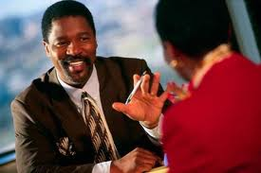
Complete your notes and/or rating sheets immediately; don’t rely on your memory.
Decide whether the candidate meets, exceeds (did well, better than your expectations), or does not meet the requirements.
Prepare for your next interview.

Slide 121
Reaching a Decision
After all the candidates have been interviewed, you will make a joint decision. Meet as a group and provide everyone with the opportunity to discuss their opinions (意见). This can be time-consuming (耗时) but if everyone is briefed as to what you are looking for, consensus (协商一致的决定) should not take too long. When a decision has been made, record your reasons for selection and non-selection.

Slide 122
Key points to remember when conducting an interview
Set the interview environment. Choose a location free from interruptions and hold all calls. Arrange a casual seating arrangement that doesn’t put the candidate in the "hot seat." If it is a panel interview, arrange the panel in a U-shape or circle.
Establish rapport (关系). Put the candidate at ease; refer to something you noted on the application to show you have carefully studied it.

Slide 123
Set the agenda (议程). Describe the interview structure; this will help you (the panel) and the candidate achieve a concise (简洁), focused interview.
Take notes. This will help you ask follow up questions and recall specifics about each candidate. Tell the candidate that you (and the panel) will be taking notes. Note key words/phrases (短语) – your notes need not be verbatim (word for word 逐字).

Slide 124
Listen carefully. Don’t anticipate the candidate’s answers (不要期望考生的答案). Reserve judgment until the person has finished (储备判断，直至该人已完成).
Maintain control. If the candidate gets off track, ask a specific question that will bring the interview back on the subject.
Allow silence and be patient (耐心等待). The candidate may need some time to put his thoughts together to provide answers to your questions.

Slide 125
Effective interview questioning
Effective questioning is the method by which you obtain information from each candidate to enable you to reach a decision. You need to plan questions in advance - both in terms of what to ask and what not to ask. Poor questioning may mean the wrong person is appointed and can also lead to discrimination.

Slide 126
Types of questions
Open-ended questions are basic to any effective interview because they call for candidates to relate information and ideas that they feel are important. Example: "Tell me about your supervisory experience.”
Accomplishment questions ask the candidate to identify important accomplishments and what competencies were used to execute them. Example: "Tell me about your most recent important accomplishment in your job. What did you do and what was the outcome?”

Slide 127
Situational questions ask candidates how they handled or would handle job-related situations, to evaluate (评估) their ability to recognise (认识) important aspects of situations, analyse them, and provide reasonable options. Example: "Describe a situation where you had two assignments with conflicting priorities (冲突的优先事项) and how you handled it."
Self-Appraisal (自我评价) or Third-Party Appraisal questions ask for the candidates’ views on how they or someone else views their performance. A third party may be a supervisor, manager, customer, etc. Example: "If I asked a customer to tell me how you well you have served them, what would he say?"

Slide 128
Direct questions are used to get very specific information, such as "What accounting courses have you had?" They are valuable for questioning applicants in depth or on topics brought up by candidates’ responses to open-ended or situational questions. Be careful in how you word your question. For example, instead of "Why were you fired from XYZ Company?" you could ask "What were the circumstances (情况) that caused you to leave XYZ Company?"
Alternate choice questions consist of two or more options. Example: "Do you prefer establishing your own work priorities (优先级) or having them pre-determined for you?"

Slide 129


Yes or no questions should be used sparingly (as little as possible) because they elicit (gain 引出) only limited information from the applicant.

Slide 130
Use the following types of question to obtain (get) more detail.
Probing Questions
These allow candidates to develop their initial answers. You use them to follow up the answer to one question with another open question. This can be a supplementary (extra) question or the first question put in a different way. They are particularly useful to find out what lies behind an answer.
For example: The candidate stated that something didn’t go as well as he has expected. To probe more, you ask: ‘Why did you feel that hadn’t gone as well as expected?’

Slide 131
Reflective Questions
Here you rephrase (另一种方式) an answer as another question and send it back to the interviewee. You can use it to check understanding or to encourage expansion of a previous answer. For example: ‘When you say you were successful, what was your benchmark (基准)?’
Hypothetical Questions
These are the ‘what if' questions. They’re designed to assess (评估) a candidate’s ability to handle particular situations related to the job. For example: ‘If that situation arose again, what would you do differently?’

Slide 132
Encouraging Questions
You can use these to express interest in a particular area of a candidate’s experience to draw out further information. They perform a similar function to probing questions but are particularly useful with timid (quiet/shy) candidates. For example: ‘I’m fascinated (interested) by your work with the youth club. How would you say the skills you use there may be of value in this new role?’

Slide 133

Closed Questions
These tend to lead to a short ‘yes’, ‘no' or ‘don’t know' answer. We tend to use closed questions as part of normal conversation (谈话). You can use them in an interview to check understanding, summarise (总结), bring the conversation back to the point if it has gone off track and to close the interview.

Slide 134
What do you hope to find out?
General areas of questioning:
Major achievements (主要成就) in previous role.
Goal setting and methods of achieving goals.
Demonstrating (展示) ability to deal with challenges and problems.
Decision making under pressure.

Slide 135
Time management and organisational abilities (时间管理和组织能力).
Setting priorities (设置优先级) and dealing with conflicting priorities (冲突的优先事项).
Use of communication skills to get a point across or persuade (说服) others to change.
Motivation of colleagues and subordinates (下属).
Dealing with poor performance.

Slide 136

Demonstrating (展示) influencing skills.
Contribution to teamwork.
Describing a problem and how this was overcome.
Ability to be flexible / adaptable.
Demonstrating creativity or flair (风骚).

Slide 137
Questions to avoid and why?
Leading Questions
These are questions that are phrased in such a way that the person is forced to provide the answer you want to hear. For example: ‘It seems to me that this is an example of performing over and above the requirements of the role. Wouldn’t you agree?’

Slide 138

Multiple Questions
This arises when several questions are put together, leading to confusion (混乱) and a poor response. For example: ‘Would you say you have strong problem-solving skills? Does the example you have outlined highlight this and how can what you have learned from that experience be applied to future situations?’

Slide 139
Discriminatory Questions
These questions have some form of discrimination, bias or stereotyping (定型的). These are not only unfair, but can lead to very public consequences should a candidate decide to take things further. Questions that have the potential of being discriminatory are usually about issues such as:
Marital status
Family/Carer responsibility
Gender
Race
Disability and ability to undertake the role
Age

Slide 140
Potentially discriminatory questions
‘There are very few women working here. Do you think you could cope (manage)?’
‘Does your condition mean you need to take time off to visit a doctor?’
‘I see you’re recently married. Do you intend to have children in the near future?’

Slide 141
‘You live rather a long way away and don’t drive. With the shift patterns here, will you be all right going to and from work in the dark?’
‘We don’t have anyone else here from an ethnic minority (少数族裔). Will you be able to cope with the jokes and banter (戏谑)?’
‘You’re older than most of our staff. How do you think you’ll fit in?’
‘What arrangements have you made for childcare while you’re at work?’

Slide 142
Sample interview questions
‘What would you say was your major achievement in your previous job?’
‘What would be an example of an important goal you set yourself in the past and how did you go about achieving it?’
‘What do you do when faced with a problem that tests your ability to cope? Give an example.’
‘How do you go about reaching decisions in pressurised situations?’

Slide 143
‘What did you do in your last role to ensure you were effective with your planning and organising?’
‘How do you deal with conflicting priorities? Use examples to illustrate (demostrate) your point.’
‘How would you use your communication skills to get your point across when others are in disagreement with you?’
‘How do you go about motivating colleagues and subordinates when you are all under pressure?’

Slide 144
Interviewing skills
Interviewing is more than asking questions. It is also about listening carefully to what you are told and interpreting (解释) the information you receive, through both oral (spoken) and non-verbal (written, body language) communication.
Listening Skills
Listening is harder than we think. This is partly because the brain can process information faster than someone can talk. Research shows that we remember only 30 per cent of what we hear. Here are some common traits (特征) that people display when listening:

Slide 145
Hearing only what we expect to hear (只听到我们希望听到什么).
Making assumptions about what the other person means (假设其他人意味着什么).
Becoming distracted (愣).
Interrupting (中断) to make a point.
Finishing someone’s sentence for them.

Slide 146
The following points may help:
Sit up straight and maintain eye contact with the interviewee, without staring (盯着). Nod and smile appropriately as they answer your questions.
Avoid being distracted (避免分心) by things around you - a ringing phone, a ticking clock or what’s going on outside the window.
Make notes to help you concentrate (帮助你集中精力) on relating the answer you are hearing to the question you have just asked.

Slide 147
Pick out the key issues they are emphasising (强调).
Ask questions to clarify any unclear responses (问问题，以澄清任何不清楚的回应) and summarise (总结) what has been said to check you understand.
Allow the other person time to speak. Don’t hurry them or finish their sentences for them.
Remember silences (being quiet) are part of the process - they allow the candidate time to think of their answer.

Slide 148
Avoid thinking of your next question until the present one has been fully answered.
Listen to the tone of voice (腔调). A high pitch (高音) may indicate an emotional response (情绪反应), while a dull (bored) tone may indicate lack of interest.
Listen for certain words or phrases that may indicate lack of conviction (缺乏信念), such as ‘I should have…’, ‘I might have …’ or ‘I tried but…’

Slide 149
Body Language
Less than 10 per cent of a first impression (第一印象) is created by what we say. As a good interviewer, you need to pay attention to body language as it can reflect (show) the candidate’s real feelings about something. It is equally important to pay attention to your own body language - or you may show your own thoughts about a candidate before giving them a fair chance.

Slide 150
The Importance of Body Language
If the language of the rest of the body appears to contradict (opposite 顶撞) what the mouth is saying, we should not believe the mouth.
Language is the most sophisticated (complicated 复杂) product of the human intellect (人类的智慧), and we spend much effort in refining (improving) and controlling our use of it. If your body indicates something different from our words, it is virtually certain to be nearer the truth.

Slide 151
The interviewer must learn to look closely for signs of unexpected tension (应力) or other spontaneous (自发) actions when interviewing. We will rarely (seldom) see the candidate actually squirm (蠕动) when we probe a particular point, but we may well observe tension or anxiety (焦虑) in the hands or eyes, or by shift of posture (姿势).
If the candidate expresses keen interest in some aspect of the job, or agrees with a statement we make, we will watch to see if his posture and expression tell the same story.

Slide 152

Be aware of the following aspects of body language:
Body orientation (身体方向) - facing you or turning the body towards you is generally a positive sign of interest and involvement. Sudden changes in orientation suggest a sudden change in reaction.
Posture - an upright posture is preferable to someone slumped in the chair as it suggests the person is alert and interested.

Slide 153
Eye Contact
Looking at you without staring (盯着) is positive. So is making eye contact with each member of the interview panel. You need to be aware, however, that in some cultures, avoiding eye contact is actually a sign of respect.
Head and Facial Movements
These should match what the person is saying. For example, answering a question positively, yet shaking the head from side to side gives out contradictory signals (矛盾的信号).

Slide 154
While you’re trying to read non-verbal communication signals from candidates, it’s equally important to be aware of the messages you send.
Positive Signals | Negative Signals
Sitting in an open position with legs and arms uncrossed | Folding your arms or sitting in a hunched position
Turning your body towards the person | Fiddling - with paper, rings or pens or ‘doodling’ when someone is talking
Being aware of their comfort zone in terms of how close you sit | Yawning, looking bored or letting your eyes wander
Making positive eye contact without staring | Shuffling and constantly changing body position
Nodding, smiling and making listening noises to help build rapport and show encouragement | Smiling inappropriately when someone is making a serious point

Slide 155
Note Taking
Note taking is essential. Make notes at the side of each question.
Use only key words or abbreviated (简短的) notes while the interviewee is speaking. It can be distracting (分心) if all the interviewee sees is the top of your head.
Use underlining or asterisks (*) to highlight important areas of your notes. Avoid using ticks and crosses as the candidate may feel they are being marked and lose confidence (信心).
Make sure your notes cover facts (事实) and not opinion (意见).

Slide 156
Remaining Unbiased
Common sources of bias (偏见) include the following:
a. Physical Attractiveness
There is evidence to show that people who are physically attractive are viewed more favourably than those who are not, irrespective of their gender.
b. Personal Liking
If a person has similar attitudes (态度), beliefs (信念) and background (来历) to you, you are likely to regard them as a favourable person.

Slide 157
c. Favourable Light
This can include having the same hobbies (兴趣爱好) or going to similar schools and colleges - all of which does not have relations to their ability to do the job.
d. Halo and Horns Effect
It is very easy to judge a candidate as all good (halo) or all bad (horns), when in fact everyone as both good and bad features. It happens when a candidate has one outstanding characteristic (特性) and the interviewer tries to minimise all the other, opposite characteristics.

Slide 158
e. Primary Bias
It’s easy to be influenced (影响) by information obtained early in the interview, whether positive or negative. The interviewer establishes their opinion in the first three minutes and spends the rest of the session trying to justify their belief.
f. Contrast Effect (对比效果)
This happens when a candidate is judged by the standard of the preceding couple of interviewees. For example, if an average candidate follows two weak ones, the average candidate is judged as strong when in fact they are not.

Slide 159
Reference Checks (参考检查)
After interviewing always check at least two references of your top candidates regardless of your impressions (印象) of the person’s qualifications. Questions asked of the reference should be job-related. A hiring mistake is costly in time, energy, and money; take the time to check references before making a job offer.

Slide 160
Check references after you have interviewed the candidate. Checking references before the interview can create false expectations (创建虚假的期望) and affect your ability to evaluate (评估) the applicant’s qualifications objectively. This includes University references.
Advise the candidate that you will be checking references and ask the candidate if it is okay to talk with their current supervisor. Ask the candidate for other references (other supervisors, customers, etc.).

Slide 161

Develop a set of job-related questions to be used on all reference checks. Like interview questions, target your questions to the competencies needed in the job (作业中所需的能力).
Example: This job involves writing and editing listings and promotional material for the team with minimal supervision. Did the candidate perform similar duties? If so, what is your assessment of the candidate’s writing and editing skills?"

Slide 162
Guidelines for Telephone Reference Checks
Introduce yourself and state the purpose of your call.
Be sure it is a convenient time to talk (方便的时间来谈论).
Briefly describe the position for which the applicant has applied.
Confirm the relationship between the person giving the reference and the applicant.

Slide 163
Verify (确认) basic data such as job title, duties, salary, and dates of employment.
Be consistent. If you check references for some applicants, do not hire another applicant without checking references. Ask the same basic questions about all applicants.
Consider other sources. If you receive negative information about an applicant, weigh it with data from other references before using it to make a decision.

Slide 164
The Importance of Reference Checks
Reference checks can reveal information about an applicant’s behaviour with prior (previous) employers, which could be critical (important) to your decision, regardless of the applicant’s skills, knowledge, and abilities. Failure to check references can have serious consequences (造成严重后果) for the organisation.

Slide 165

Selection
Now that you have interviewed and conducted reference checks on your top candidates, it is time to select the candidate who best meets the requirements of your position.

Slide 166
Guiding Principles
Your goals are to:
Choose the best candidate for the position based on qualifications.
Help the organisation carry out its goal by selecting excellent employees.
Ensure that if applicants are equally qualified, the selection is normally made based on benefits.

Slide 167
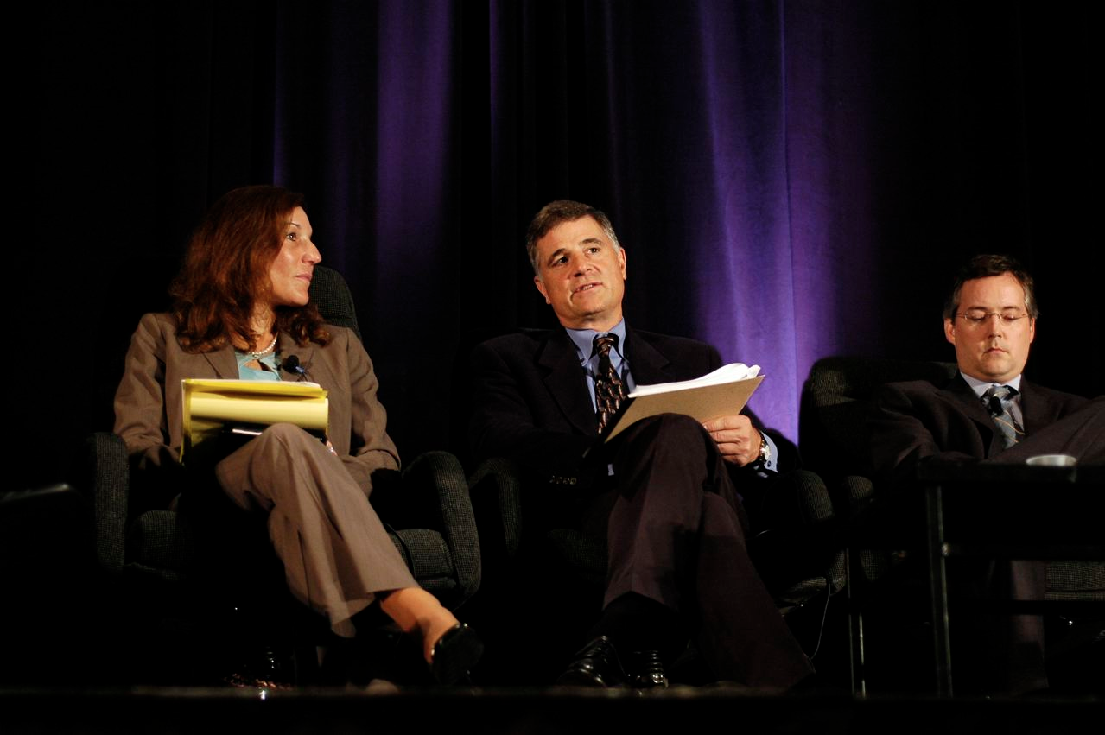
Establish salary rates that will lead to the retention and motivation of competent employees.
Give a professional and positive image of the organisation by quickly notifying all applicants of your decision.

Slide 168
Before you make the selection and notify applicants, review (回顾) the recruitment and interview process to be sure you followed these guidelines:
Duties and responsibilities of the position were accurately described and reflected (准确地描述和反映) in the qualifications needed to perform those duties and responsibilities
Selection criteria used to assess a candidate were based on qualifications listed for the position.
Interview questions clearly matched the selection criteria.

Slide 169

Wherever appropriate, Interviews were conducted by a committee to ensure an objective decision.
All candidates were treated uniformly (the same) in the recruitment, screening, interviewing, and final selection process.

Slide 170
! Assignment
Explain a recognised selection technique that could be used during interviews. (16 marks)
Guide: A detailed explanation is given of a recognised selection technique that could be used during interviews.

